Slide 1
DUCHELLE BLANCHE KEMOUE FEUKOU DATA 205-CRN 22017

Slide 2

Montgomery County Employees' Salary Analysis: Trends and Insights
This project examines Montgomery County employee salary data from 2019 to 2023, exploring salary growth, inflation alignment, and gender pay gaps. I will uncover insights into workforce equity and economic trends using data from DataMontgomery and the Bureau of Labor Statistics using Python libraries such as Python, Matplolib, and Seaborn.
The analysis aims to answer key questions about salary evolution, gender disparities across departments and job grades, and patterns in salary differences across various sectors. The findings could provide valuable insights for policymakers and organizational leaders.

Slide 3
Project Goals
Analyze Salary Growth vs. Inflation
Identify Gender Pay Gaps
Examine how employee salaries have changed over time in relation to inflation rates.
Investigate potential disparities in pay between genders across departments and job grades.
Uncover Salary Patterns
Explore patterns in salary differences across various sectors within Montgomery County.

Slide 4

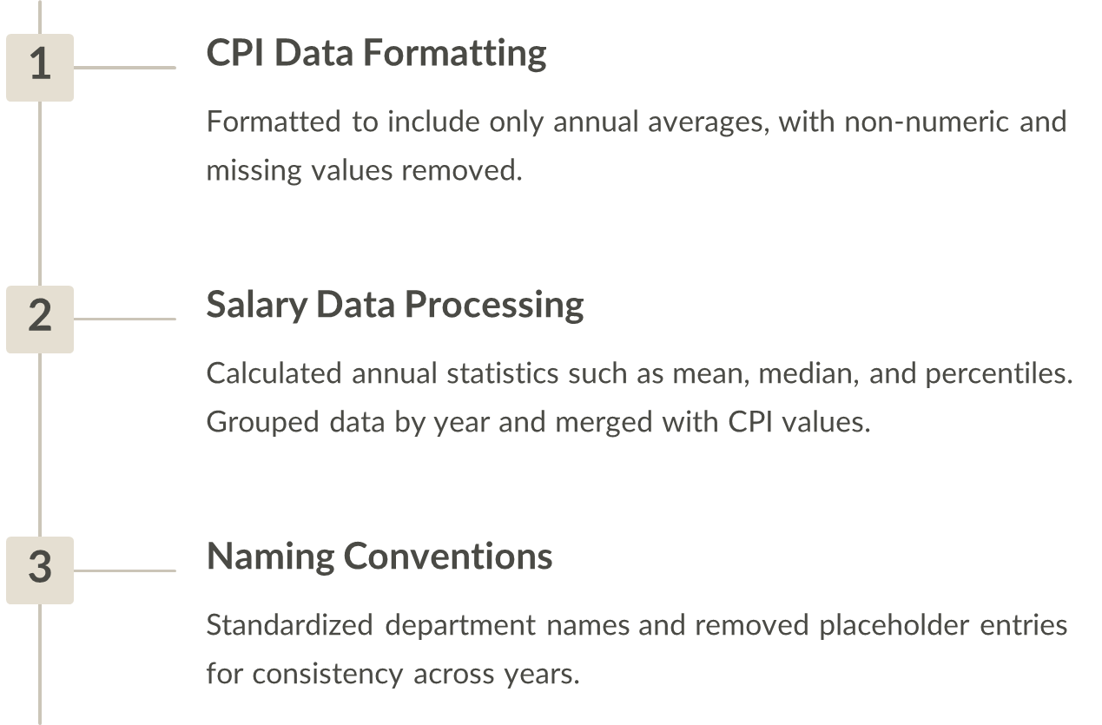
Data Preparation and Cleaning

Slide 5
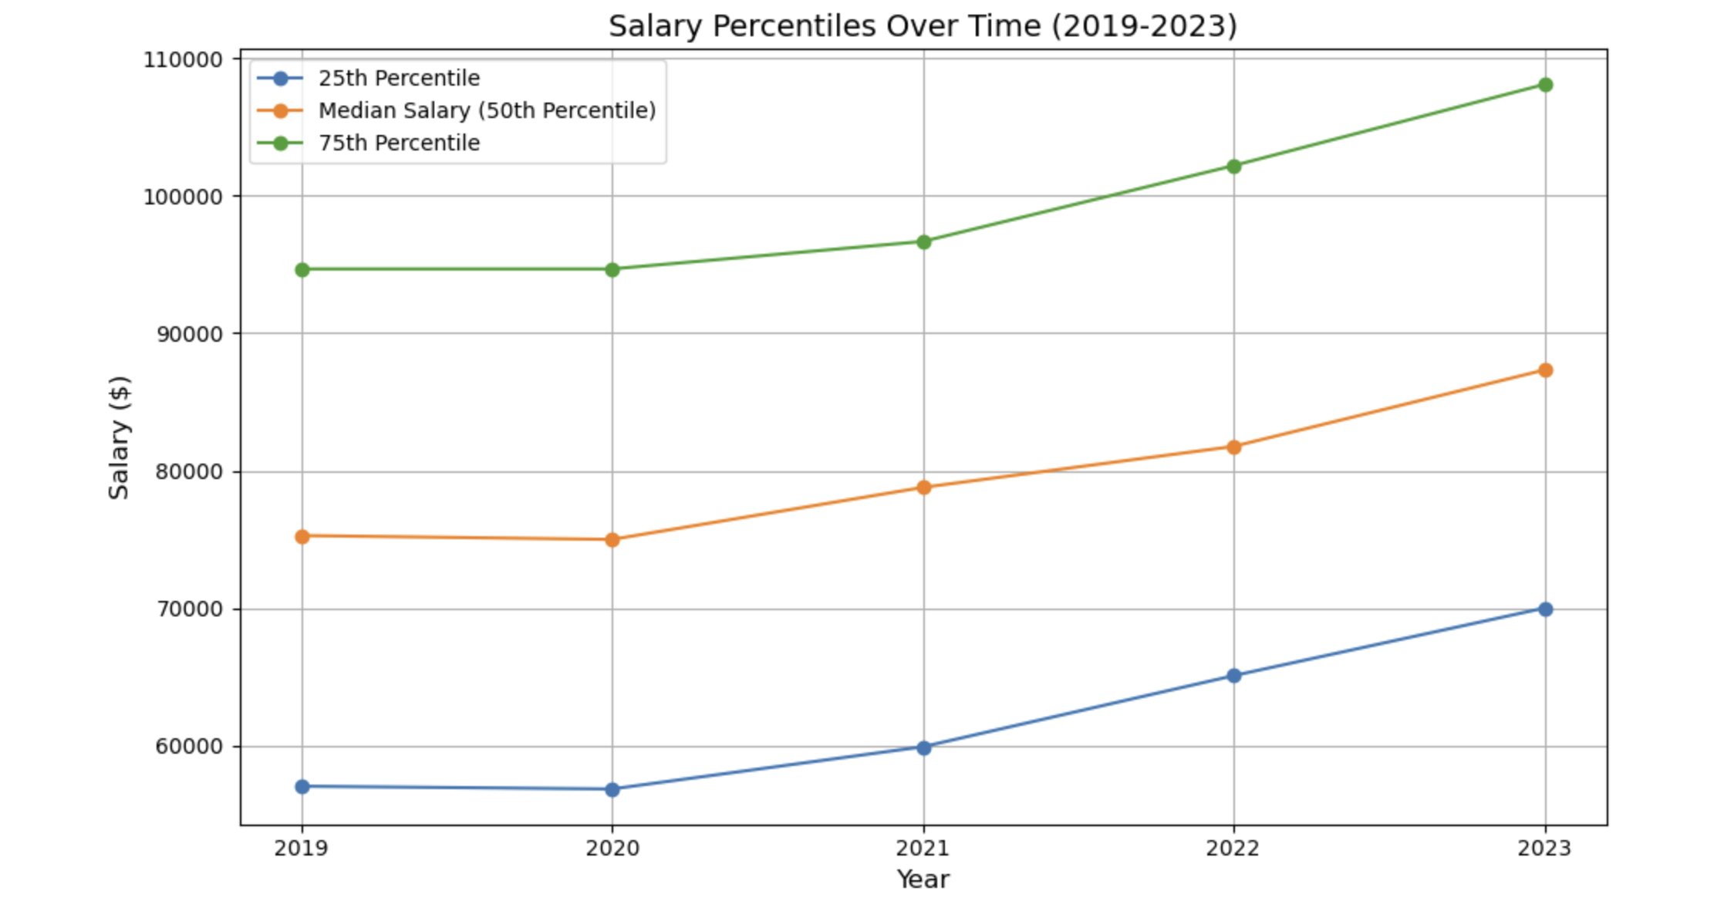
Salary Trends Over Time
25th Percentile Growth
Median and 75th Percentile
Experienced the highest growth rates overall, particularly in 2022 and 2023.
Grew at a slower but steady pace, with notable acceleration in 2023.

Slide 6



Salary Growth vs. Inflation
2020-2022
2020: the ratio was negative, indicating that salary growth not only lagged behind inflation but also declined
2021: salary growth was about to match inflation
2022: ratio dropped below parity, indicating that inflation outpaced salary growth
2023
Salary growth finally outpaced inflation, marking a significant improvement in purchasing power.
Overall Trend
Weak relationship between inflation and salary growth, suggesting other factors may be more influential.

Slide 7
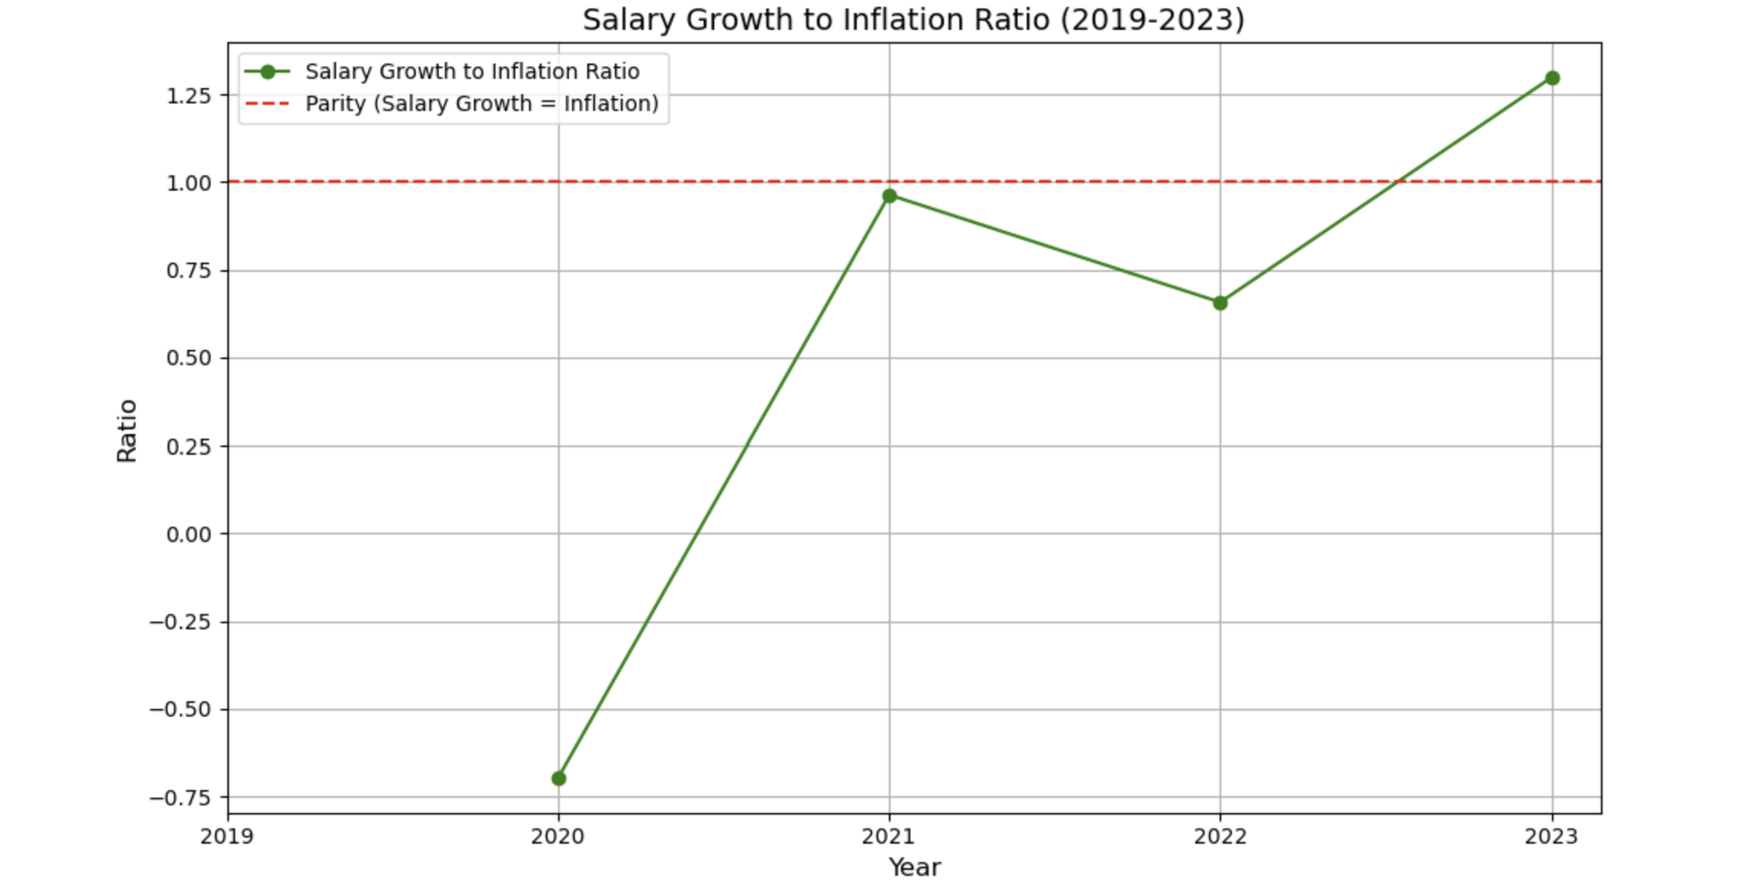
The top figures indicate periods when salary growth outpaced inflation, while the bottom figures represent periods when inflation exceeded salary growth. The red striped lines denote periods where salary growth and inflation were equal.

Slide 8
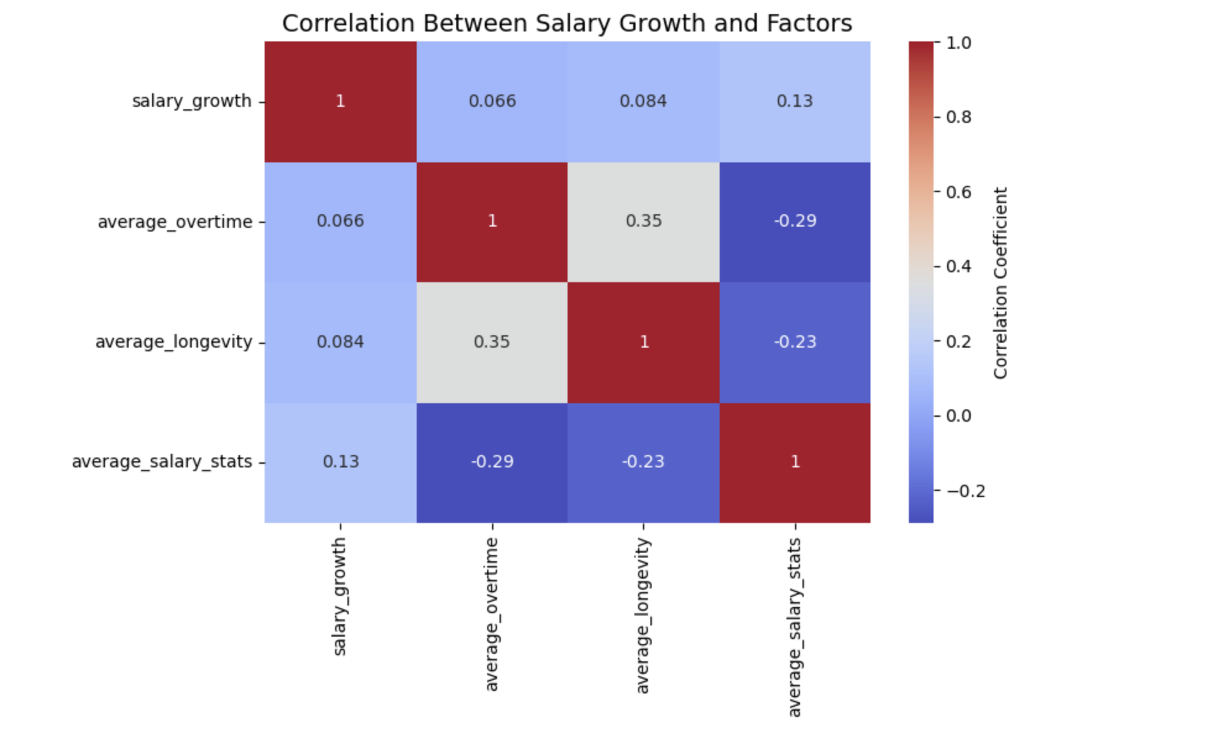

Slide 9
Gender-Based Salary Analysis
Lower-Paying Categories
Higher-Paying Categories
Men are overrepresented compared to women, indicating potential systemic factors.
More balanced representation between men and women, but disparities still exist.
Job Grade Variations
Pay gaps fluctuate across job grades and years, revealing complex patterns of inequality.

Slide 10
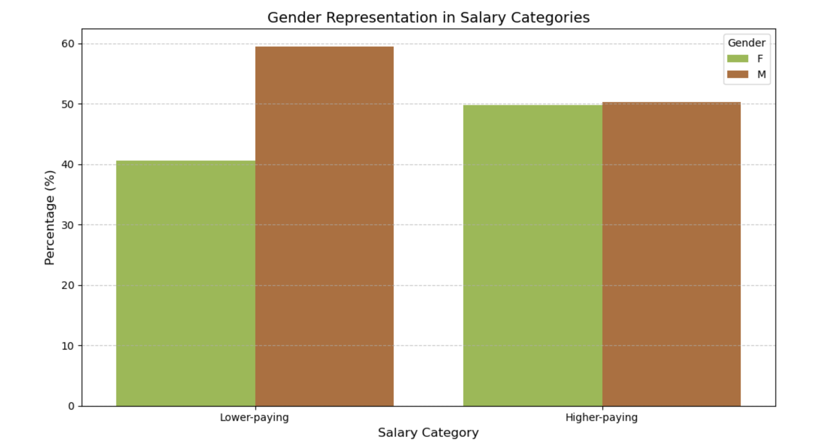
Considering departments, men are more represented in lower paying jobs because most of the them are physically demanding or labor-intensive and perceive as “masculine”, such as manufacturing, construction, or security.

Slide 11
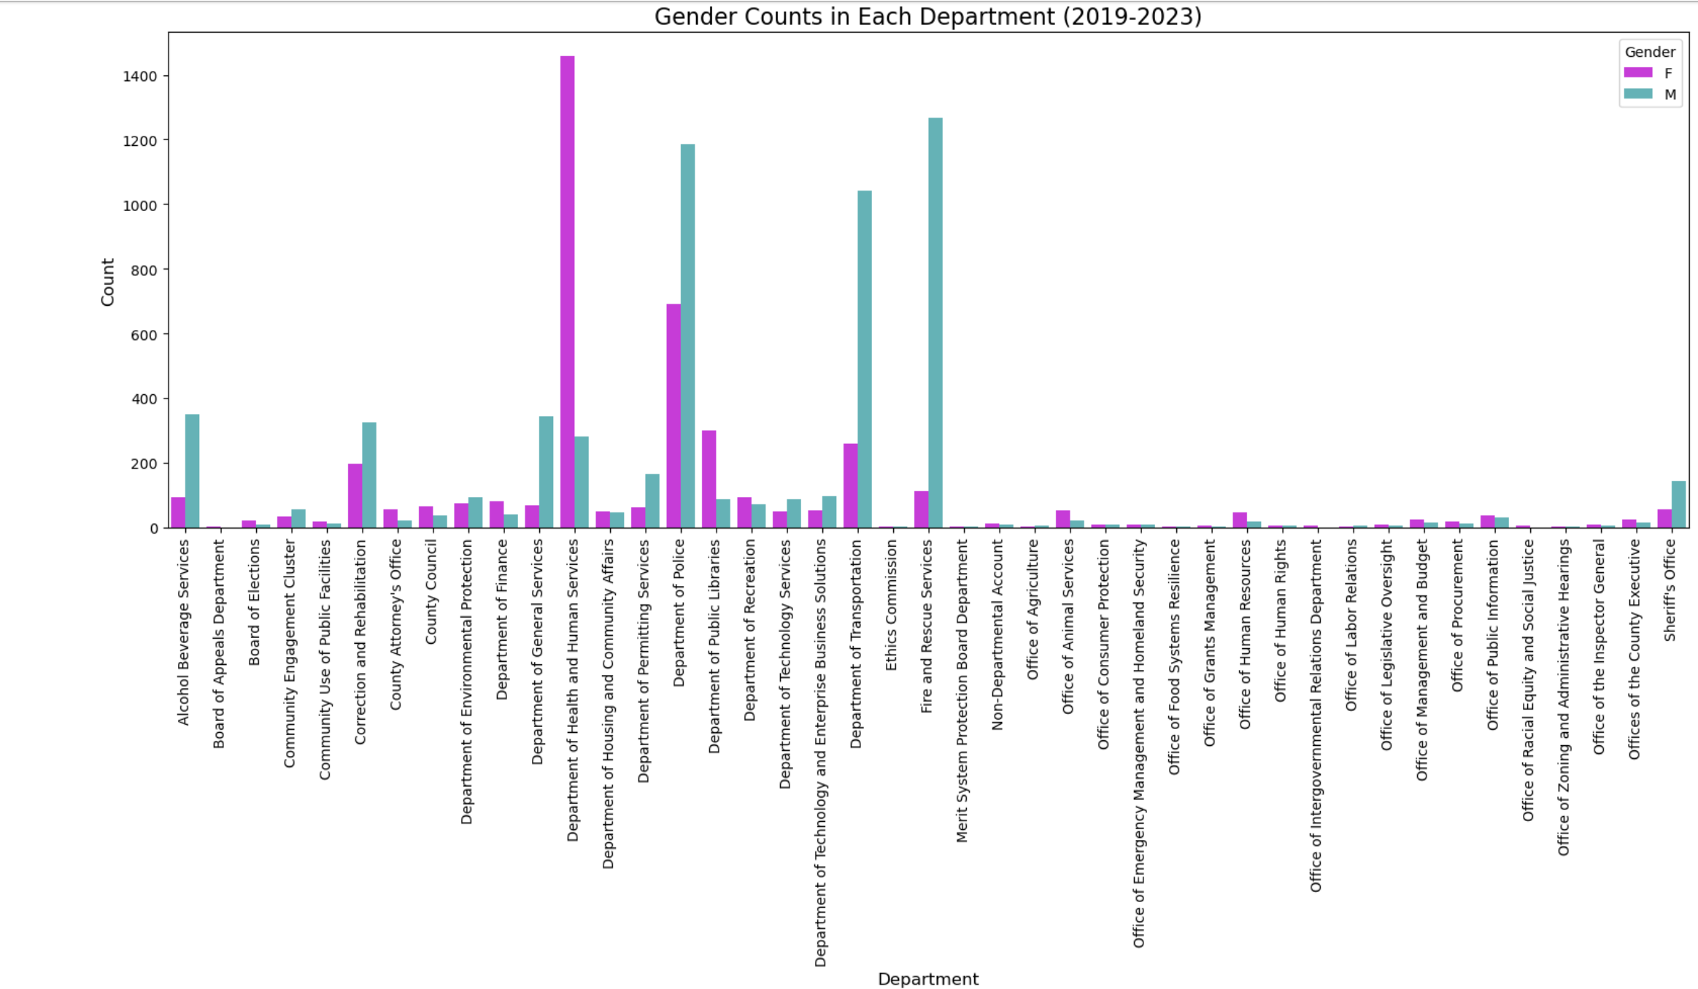
Significant representation of women in the department of health and human services.
Significant representation of men in the departments of police, of transportation, and fire and rescue services

Slide 12
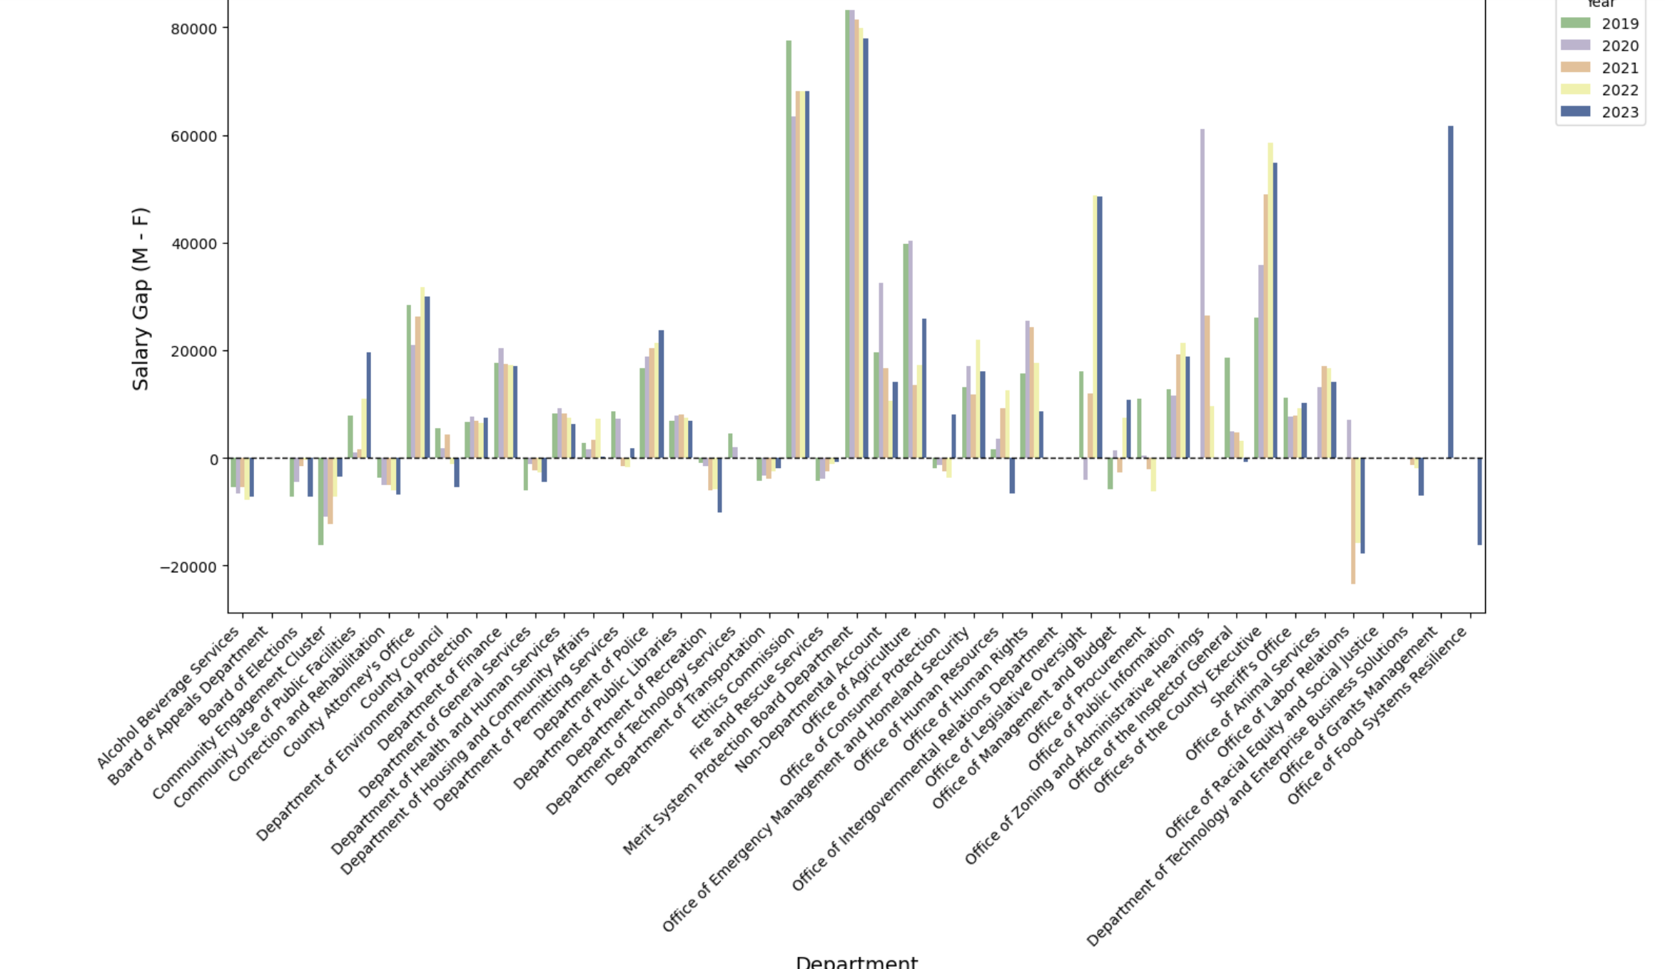
Salary Gap by Department and Year (2019-2023)
Positive bars represent departments where male employees earn higher average salaries than their female counterparts, while negative bars indicate departments where female employees earn higher average salaries than males.

Slide 13
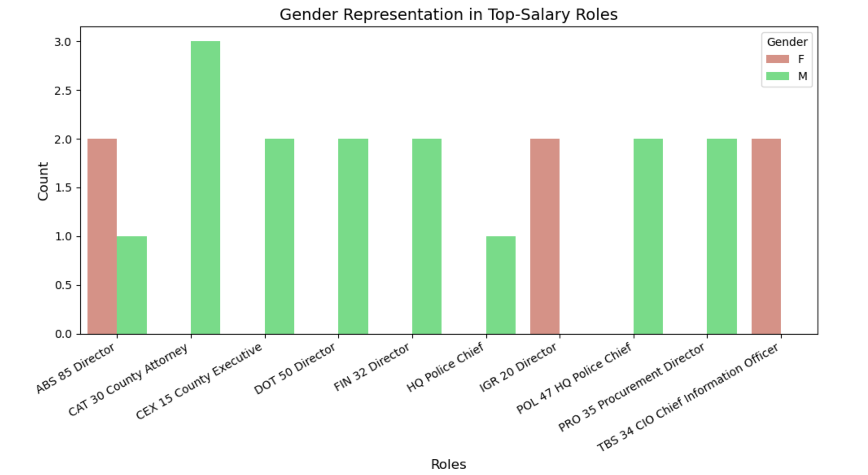
Defining divisions as roles, men are more represented than women in the divisions that earn the most.

Slide 14
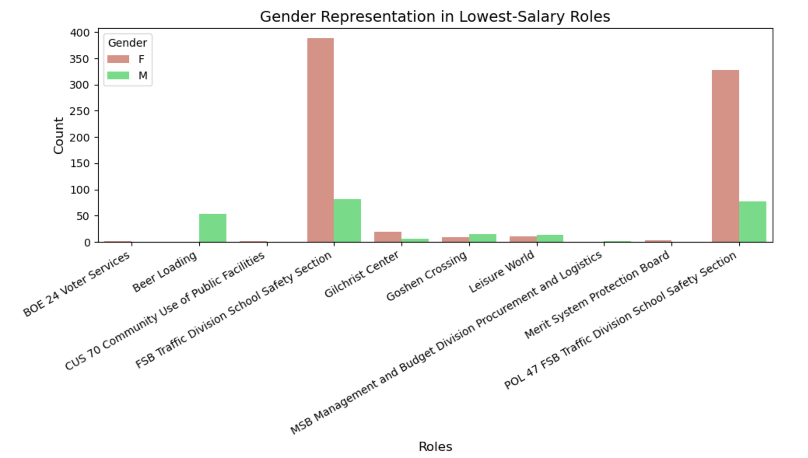
Contrary to what was observed with departments, when analyzing the lowest-paying divisions, it appears that women are the most represented although the distribution is not even.

Slide 15
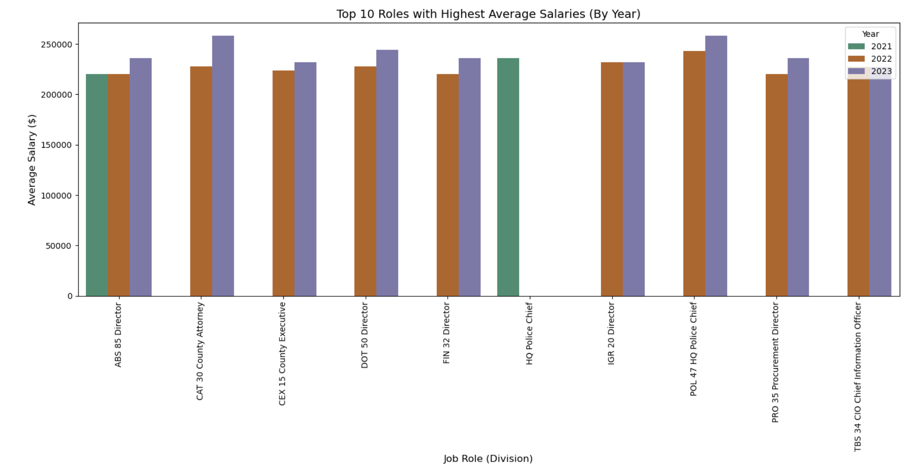
Salary Patterns Across various Sectors
Highlighting the top 10 highest-paying roles from 2021 to 2023, the "POL 47 HQ Police Chief" and "CAT 30 County Attorney" consistently rank among the highest-paid positions

Slide 16
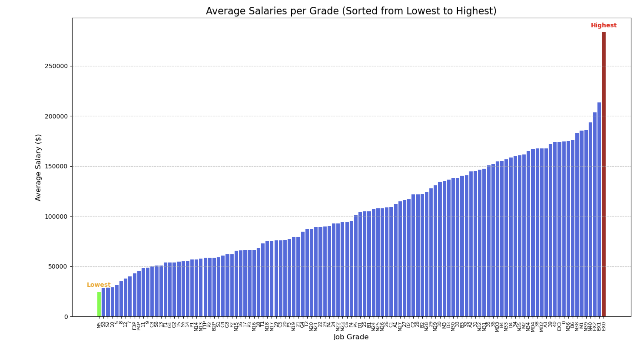
This chart illustrates Montgomery County's salary structure, showing a progression from entry-level roles with lower pay (green bar is the lowest) to executive roles with significant responsibilities and higher pay (red bar is the highest), highlighting the link between job grade, responsibility, and compensation.

Slide 17



Implications for Policy and Leadership
Compensation Adjustments
Equity Initiatives
Strategic Planning
Inform decisions on salary adjustments to better support employees in light of inflation.
Address gender pay gaps and departmental disparities to enhance workforce equity.
Use insights to develop long-term strategies for fair and competitive compensation.

Slide 18
Challenges and Rewards
Challenges
Addressing inconsistencies in department names and handling placeholder grades required diligence and careful adjustments to maintain data integrity.
Bootstrapping analysis revealed weak and inconsistent relationships, which complicated definitive interpretations
Merging salary data with CPI and Employment Cost Index data required reconciling different formats and levels of granularity.
Technical issues.
Rewards
Being able to use Python libraries to uncover valuable insights regarding salary growth trends, inflation gap, and gender pay comparison.
Coming over with impactful and understandable visualizations to communicate the findings.
Skill growth

Slide 19
References
1. Montgomery County Employee Salaries Data: dataMontgomery.gov
https://data.montgomerycountymd.gov/Human-Resources/Employee-Salaries-2019/qatd-z57d/data_preview
https://data.montgomerycountymd.gov/Human-Resources/Employee-Salaries-2020/he7s-ebwb/data_preview
https://data.montgomerycountymd.gov/Human-Resources/Employee-Salaries-2021/kmkb-bmhe/data_preview
https://data.montgomerycountymd.gov/Human-Resources/Employee-Salaries-2022/njz9-yp4y/data_preview
https://data.montgomerycountymd.gov/Government/Employee-Salaries-2023/iv8c-428b/data_preview
2. Consumer Price Index Data: Bureau of Labor Statistics https://fred.stlouisfed.org/series/CUURA102SA0#0
3. United States Employment Cost Index: Bureau of Labor Statistics https://www.bls.gov/eci/home.htm

Slide 20
Acknowledgements
Professors: Jane Valentine, Rachel Saidi, Abdirasak Mohamed
Mentor: Silvere Ngouela
DataCamp courses.
Classmates

